Slide 1
Receipt Management for Payment wallet applications

Slide 2
Team Members
1. Simer Preet Singh - 02511804425
2. Mehul Sharma - 01411804425
3. Pragya Tyagi - 01611804425
4. Raunak Saluja - 03811804425
5. Keshav Mishra- 04811804425
6. Kanishk Chauhan- 05011804425

Slide 3
Brief about the idea
ReceiptAI is an innovative and sophisticated mobile application developed to revolutionize personal financial management by leveraging the power of artificial intelligence (AI) and optical character recognition (OCR) technologies.
The application enables users to effortlessly capture images of their physical receipts using their smartphone camera. Once the image is uploaded, ReceiptAI’s advanced OCR engine automatically scans and extracts key details—such as merchant name, date, category, and total amount—eliminating the need for manual data entry.
Through intelligent data categorization and analysis, the app provides users with a clear and organized overview of their spending habits. ReceiptAI not only tracks expenses in real-time but also identifies trends, detects anomalies, and provides personalized financial insights to help users make smarter budgeting and saving decisions.

Slide 4
The Problem struggles to manage personal finances because
struggle to manage personal finances because:
Receipts get lost – paper or digital, they vanish quickly
Manual tracking is exhausting – typing every expense leads to errors & abandonment
No real-time clarity – users can’t see where money goes until it’s too late
Generic apps fail to engage – static charts and no personalized guidance
70% of users abandon budgeting apps within 30 days due to friction and a lack of insight.

Slide 5
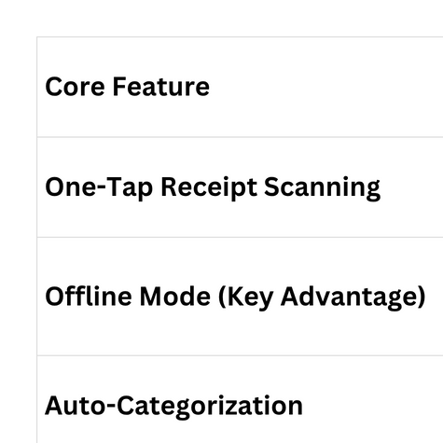
Our Solution: ReceiptAI application that works for Everyone

Slide 6
List of features offered by our solution:
• Receipt Capture & Data Extraction
Users may upload images (PNG/JPG) or use the device camera. Advanced OCR (via Google ML Kit) accurately identifies the total amount, the merchant name, and the transaction date.
• Automated Expense Categorization
Transactions are intelligently classified into predefined categories such as Groceries, Dining, Transport, and Coffee using rule-based and contextual analysis.
• Insights Dashboard
A dedicated analytics view presents spending aggregated by category, displayed through clear, interactive bar charts for comprehensive financial visibility.

Slide 7
• Budget Overview
A dynamic pie chart visualization illustrates the proportional distribution of monthly expenditures across all categories.
• AI-Powered Financial Assistant
Integrated with xAI’s Grok API, the assistant enables natural language queries (e.g., “What is my total spending on groceries this month?”) and delivers personalized, data-driven responses and savings recommendations.
• Offline Functionality
Receipt processing and local storage are supported without an internet connection; data synchronizes seamlessly upon reconnection.
wallet pass

Slide 8
• Data Privacy & Security
On-device OCR processing, end-to-end encryption, and compliance with privacy standards ensure user data remains secure and confidential. No banking credentials are required or stored.

Slide 9
Technologies to be used in the solution
Flutter – Cross-platform mobile development (iOS & Android)
Google ML Kit – On-device OCR for receipt scanning
Firebase – Real-time database, auth, and storage
xAI Grok API – AI-powered financial assistant
fl_chart – Interactive budget visualizations

Slide 10
Architecture diagram of the proposed solution

Slide 11
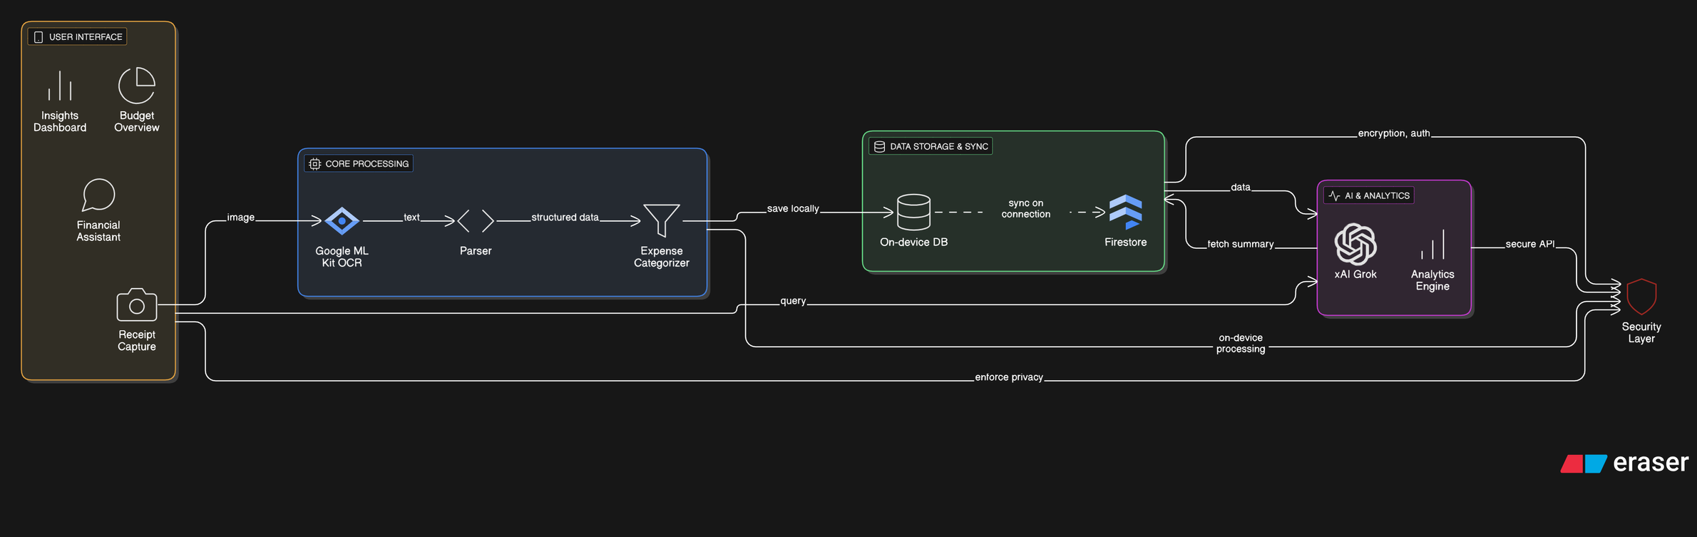

Slide 12
References
Google ML Kit – Text Recognition Google. (2025). ML Kit Text Recognition API. Retrieved from https://developers.google.com/ml-kit/vision/text-recognition
Firebase Documentation Google. (2025). Firebase: Build, improve, grow. Retrieved from https://firebase.google.com/docs
xAI Grok API Reference xAI. (2025). Grok API Documentation. Retrieved from https://x.ai/api
fl_chart – Flutter Charting Library Iman, A. (2025). fl_chart: Beautiful charts for Flutter. Retrieved from https://pub.dev/packages/fl_chart
Optical Character Recognition (OCR), in Mobile Devices Patel, C., Patel, A., & Patel, D. (2022). Real-time text detection and recognition on mobile platforms using deep learning. International Journal of Computer Applications, 184(15), 23–30. DOI: 10.5120/ijca2022922134

Slide 13
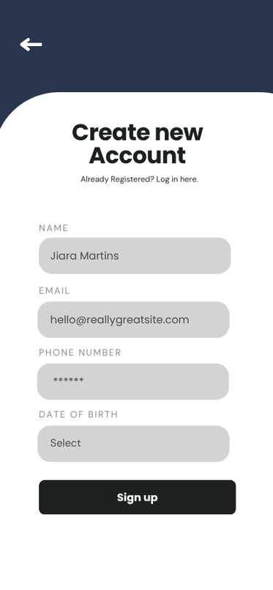
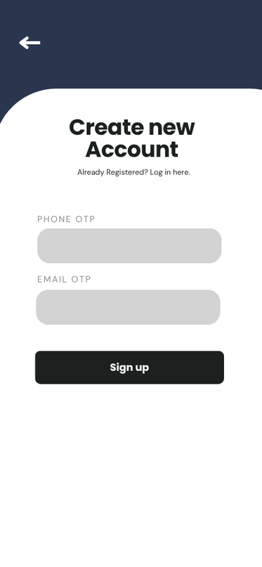
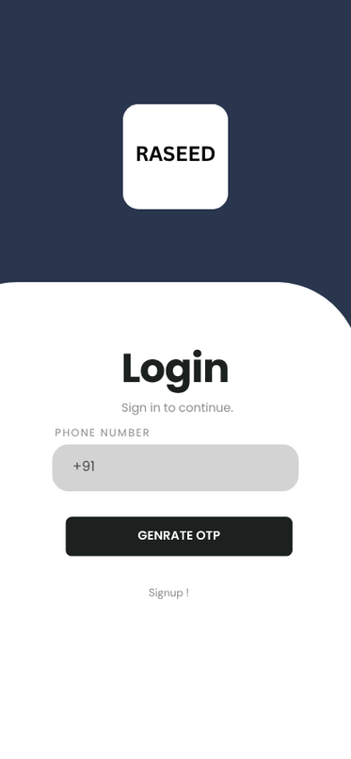
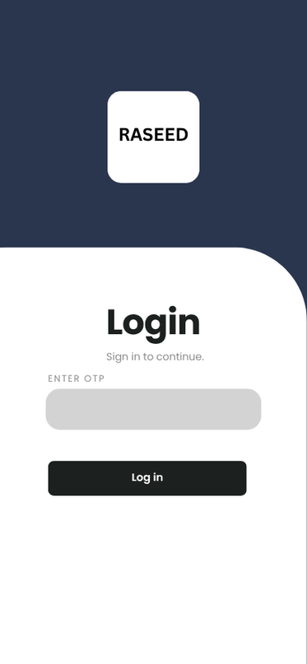
Wireframes/Mock diagrams
Registration and Log in

Slide 14
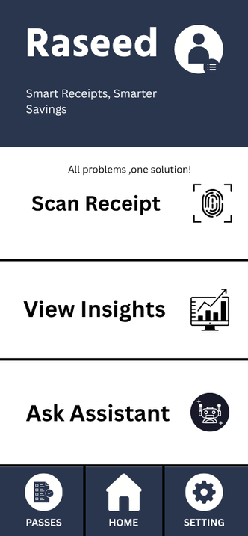
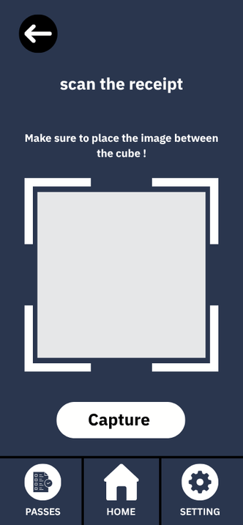
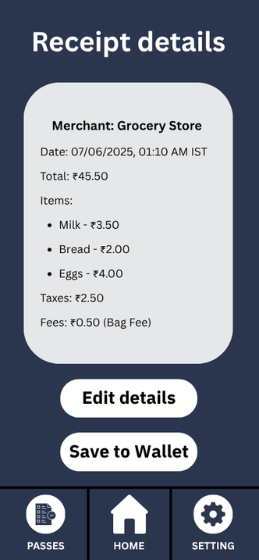

Receipt
scanning
&
saving

Slide 15
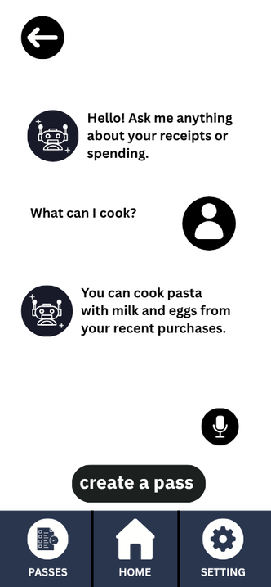
Ask
assistant

Slide 16
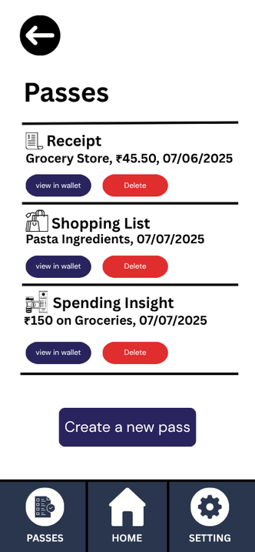
View
passes

Slide 17
Thank You

